Slide 1

Global YouTube Statistics Analysis
S.K2304
Finlatics Data Science

Slide 2

Introduction
This project marks my journey into the world of data science through the lens of one of the most dynamic digital platforms — YouTube.
Working with a real-world dataset of nearly 1,000 YouTube channels, I had the opportunity to practice essential data science skills, including:
Data cleaning and preprocessing
Exploratory Data Analysis (EDA)
Data visualization
Drawing meaningful insights from patterns in large datasets
The goal was not only to uncover interesting trends within YouTube data, but
more importantly, to develop an analytical mindset — one that asks the right
questions, interprets results critically, and communicates findings clearly.
Throughout this project, I learned how to work with messy data, how to structure an investigation, and how to translate numbers into visual stories. This presentation walks through that process and highlights what I discovered along the way.

Slide 3
Data Pre-processing
Before beginning the analysis, I performed thorough data preprocessing to ensure the accuracy and consistency of results.
Missing values in key categorical columns such as Category, Channel Type, and Country were filled using the most frequently occurring values (mode) to retain dominant and meaningful classifications.
I converted date-related columns into proper datetime format and extracted new time-based features such as the Month of Channel Creation and Channel Age in Months, which enabled more insightful temporal analysis.
I also created new features, including Average Monthly Earnings—calculated as the mean of the estimated earning range—and Subscribers per Month, which normalized subscriber growth based on how long each channel has existed.
Aggregated metrics such as averages and totals were computed across categories and countries to enable meaningful comparisons.
These steps laid the groundwork for clean, interpretable visualizations and allowed for robust correlation analysis and pattern discovery across various aspects of the dataset.

Slide 4

What are the top 10 YouTube channels based on the number of subscribers?
01
To answer this, I sorted the dataset in descending order based on the number of subscribers and selected the top 10 entries. This approach ensures that we identify the most followed YouTube creators globally.

Slide 5
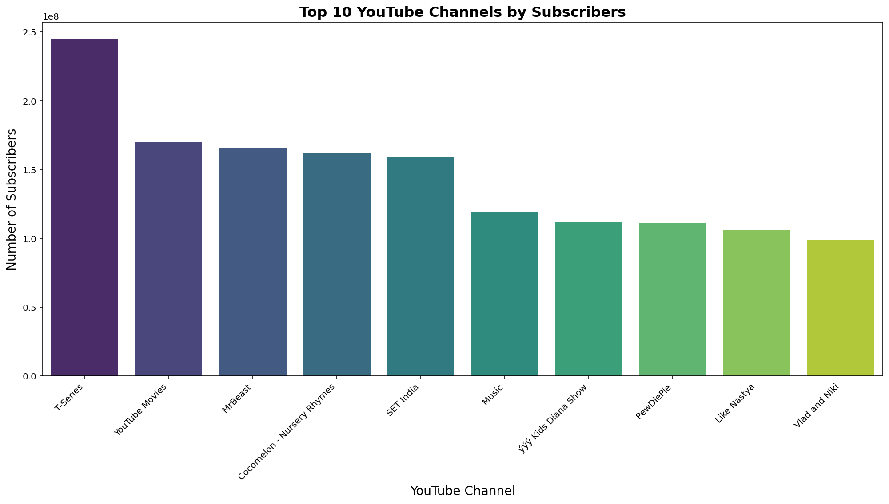

Slide 6
Visualizing the results through a horizontal bar chart provided a clear comparison between subscriber counts. The analysis revealed a significant gap between the top few creators and the rest, indicating a highly skewed distribution where a small number of channels dominate audience attention. This insight sets the stage for understanding content dominance and popularity concentration in the YouTube ecosystem.
MY INSIGHTS

Slide 7
Which category has the highest average number of subscribers?
02
To explore this, I grouped the data by channel category and calculated the average number of subscribers within each group. This allowed for a fair comparison across content types, regardless of how many channels existed in each category.

Slide 8
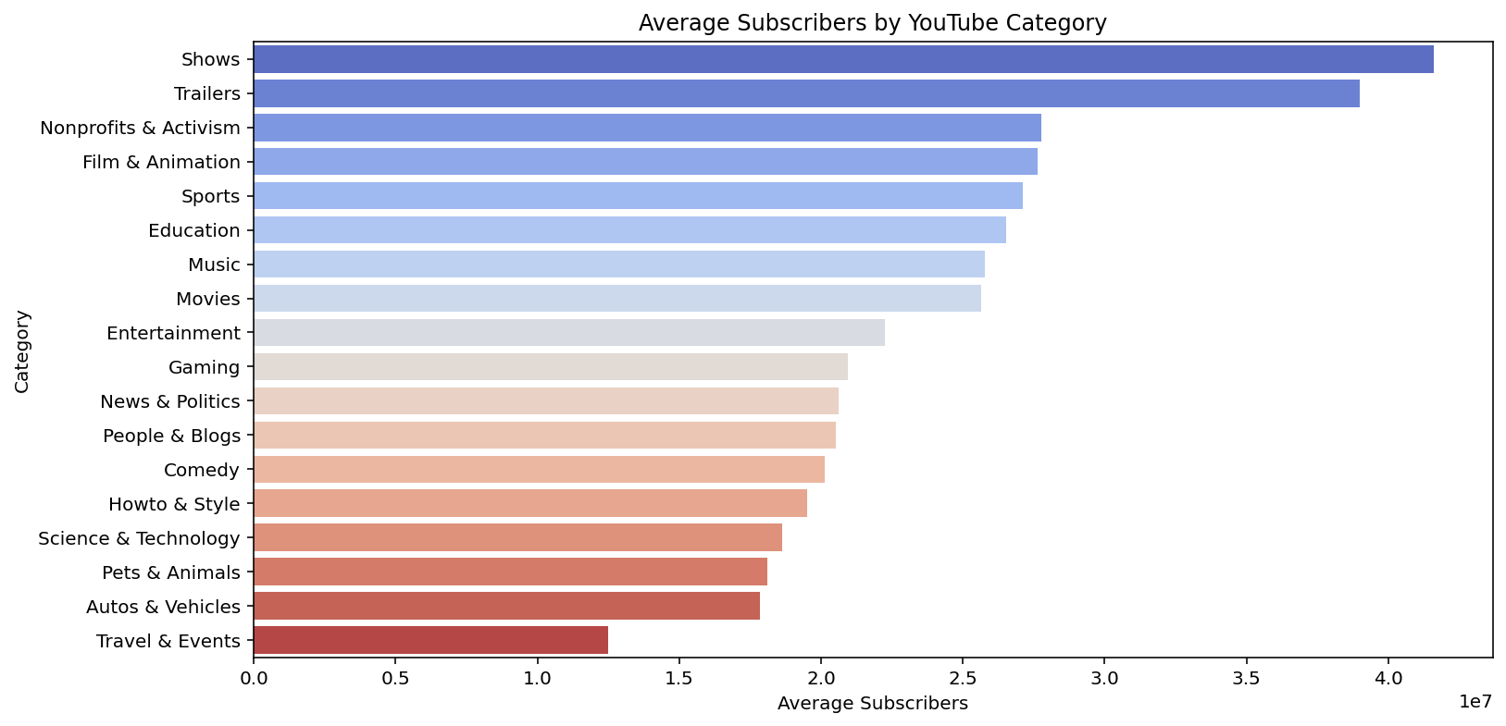

Slide 9
MY INSIGHTS
By visualizing these averages in a bar plot, the analysis highlighted which content areas tend to attract the largest audiences on average. The results showed that certain categories—such as music or entertainment—consistently pull higher subscriber counts, suggesting broader appeal or more consistent viewer engagement.
Interestingly, Education and Non-Profit channels also showed notable subscriber averages. This reflects a growing trend in online learning and digital activism, particularly in recent years, where educational content has seen an explosive rise in engagement—likely accelerated by global shifts toward remote learning and knowledge sharing.
This insight is valuable for understanding audience preferences and the kinds of content that scale well on YouTube.

Slide 10
How many videos, on average, are uploaded by YouTube channels in each category?
03
To answer this, I grouped the data by channel category and computed the average number of video uploads per category. This provided insight into the content production behavior of creators in different niches. The goal was to understand which categories tend to have higher or lower content output on average

Slide 11
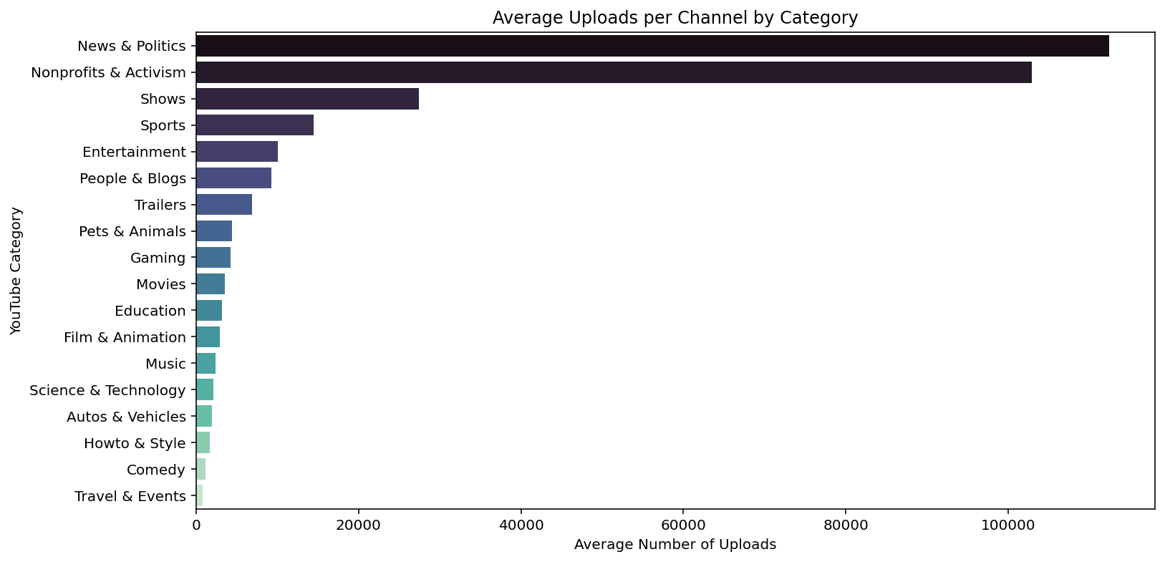

Slide 12
MY INSIGHTS
The analysis revealed some interesting and perhaps unexpected trends. News & Politics ranked first in terms of average uploads, likely due to the fast-paced, constantly evolving nature of the news cycle. This was followed by Non-Profit & Activism, which suggests that such channels are actively creating content to raise awareness and engage their audiences. Shows and Sports also ranked high, reflecting the episodic or event-based structure of their content, which naturally supports frequent uploads but falls far short of News and Non-Profit.
These findings highlight how the demands of a content niche influence publishing behavior, with high-frequency categories typically tied to current events, advocacy, or serialized formats.

Slide 13
What are the top 5 countries with the highest number of YouTube channels?
04
To identify the top countries dominating the YouTube space, I analyzed the frequency of channels by country using a simple value count approach on the “Country” column. This allowed me to rank nations based on how many YouTube channels are associated with them.

Slide 14
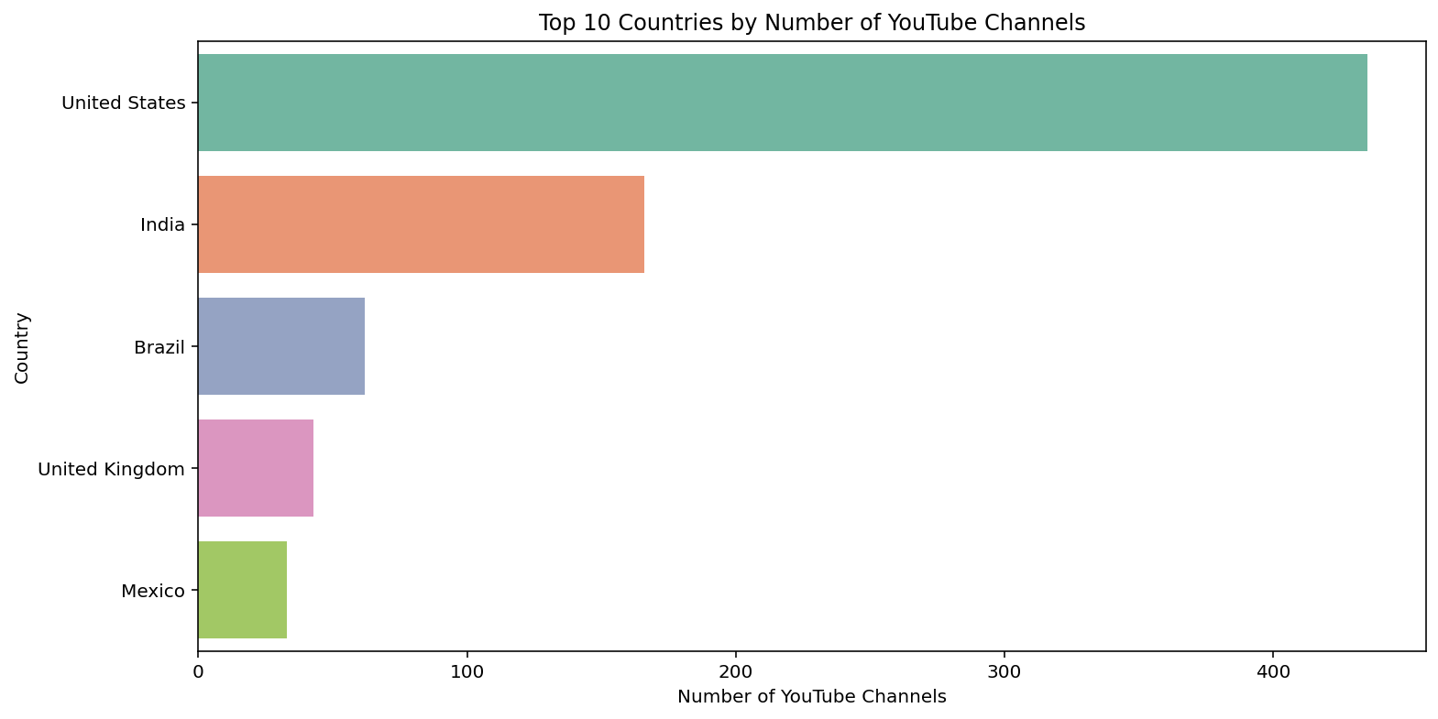

Slide 15
MY INSIGHTS
The results revealed that the United States leads by a large margin, followed by India, Brazil, United Kingdom, and Mexico. These countries not only have large populations but also widespread internet access and strong digital media ecosystems, contributing to high content creation activity.
This distribution underscores the global nature of YouTube while also highlighting how socioeconomic factors like internet penetration, digital literacy, and media culture shape platform participation across regions.

Slide 16
What is the distribution of channel types across different categories?
05
To explore how YouTube channel types vary across content categories, I created a stacked bar chart showing the count of channels by type within each category. This allowed for visual comparison of both the volume and diversity of channel types.

Slide 17
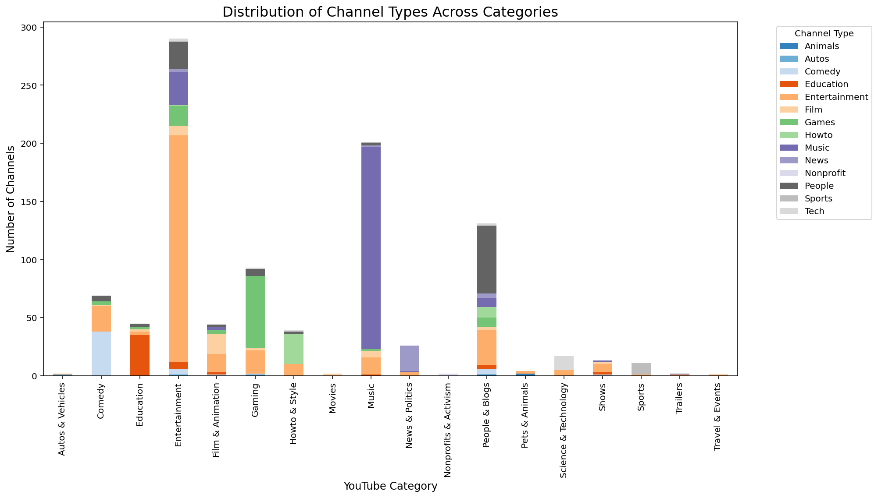

Slide 18
MY INSIGHTS
The results showed that Entertainment, Music, and People & Blogs have the highest total number of channels. This reflects the popularity and broad accessibility of these content genres, which cater to massive, global audiences.
Interestingly, the People & Blogs category displayed the widest variability in channel types, suggesting it acts as a flexible umbrella category where creators from various niches—like lifestyle, education, sports, and even tech—choose to classify their content. This makes it a dynamic and diverse category worth deeper exploration.
This analysis provides key insights into how creators choose to classify their content and the saturation levels within popular niches.

Slide 19
Is there a correlation between the number of subscribers and total video views for YouTube channels?
06
To analyze this relationship, I calculated the correlation coefficient between the number of subscribers and total video views of YouTube channels.

Slide 20
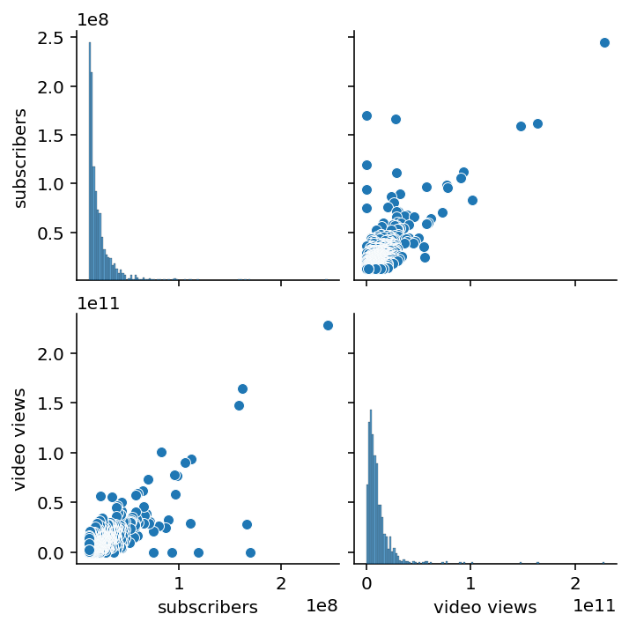
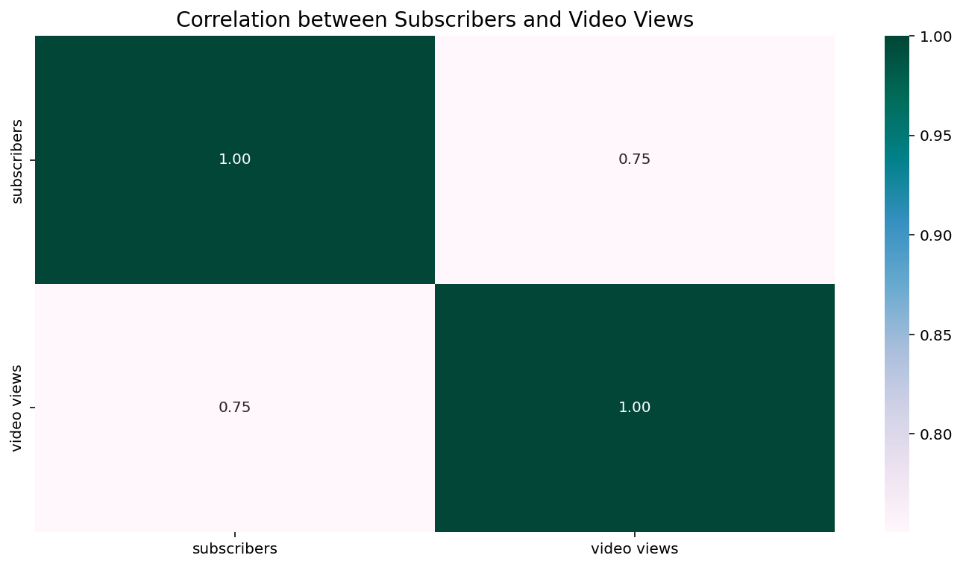

Slide 21
The result was a strong positive correlation of 0.75, which means that channels with more subscribers generally also tend to have more video views. I also visualized the relationship using a heatmap and a pair plot. The pair plot revealed that although the trend is upward, there are a few notable exceptions—some channels achieve significantly high views despite fewer subscribers, possibly due to viral content or high viewer retention. This analysis shows that while subscriber count is a good indicator of reach, it's not the only metric that determines viewership. Understanding both correlation values and visual trends is important for gaining deeper insights into content performance and audience behavior.
MY INSIGHTS

Slide 22
How do the monthly earnings vary throughout different categories?
07
To determine which content types are the most lucrative, I calculated and visualized the average monthly earnings across different YouTube video categories.

Slide 23
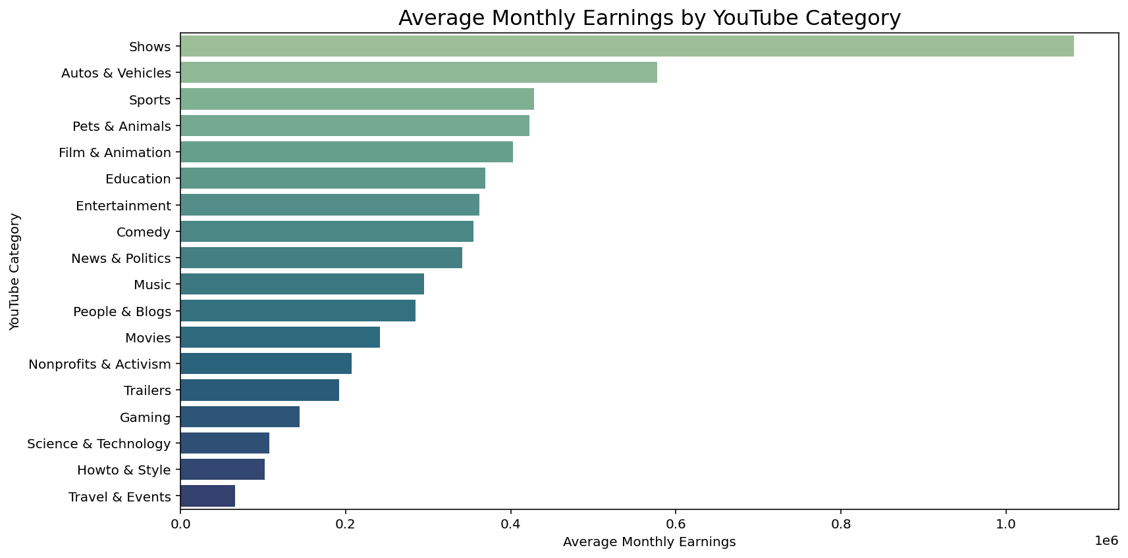

Slide 24
MY INSIGHTS
The bar chart reveals that “Shows” is by far the highest-earning category, generating well over 1 million per month on average. It is followed by “Autos & Vehicles”, “Sports”, and “Pets & Animals”.
Interestingly, categories like “Education” and “Nonprofits & Activism” appear mid to low in the earnings hierarchy. However, this does not necessarily indicate a lack of growth potential. In fact, recent years have seen a notable surge in educational content and non-profit outreach on YouTube, especially during and after the pandemic, as digital learning and online activism expanded rapidly. This trend suggests an emerging market value in these categories that might not yet be fully captured by average earnings metrics alone.
This analysis highlights how entertainment-focused and commercially appealing categories dominate revenue, but also points to growing opportunities in impact-driven and knowledge-sharing domains.

Slide 25
What is the overall trend in subscribers gained in the last 30 days across all channels?
08
To understand recent channel growth, I analyzed and visualized the distribution of subscribers gained over the last 30 days, revealing a positively skewed trend with a few channels experiencing rapid gains.

Slide 26
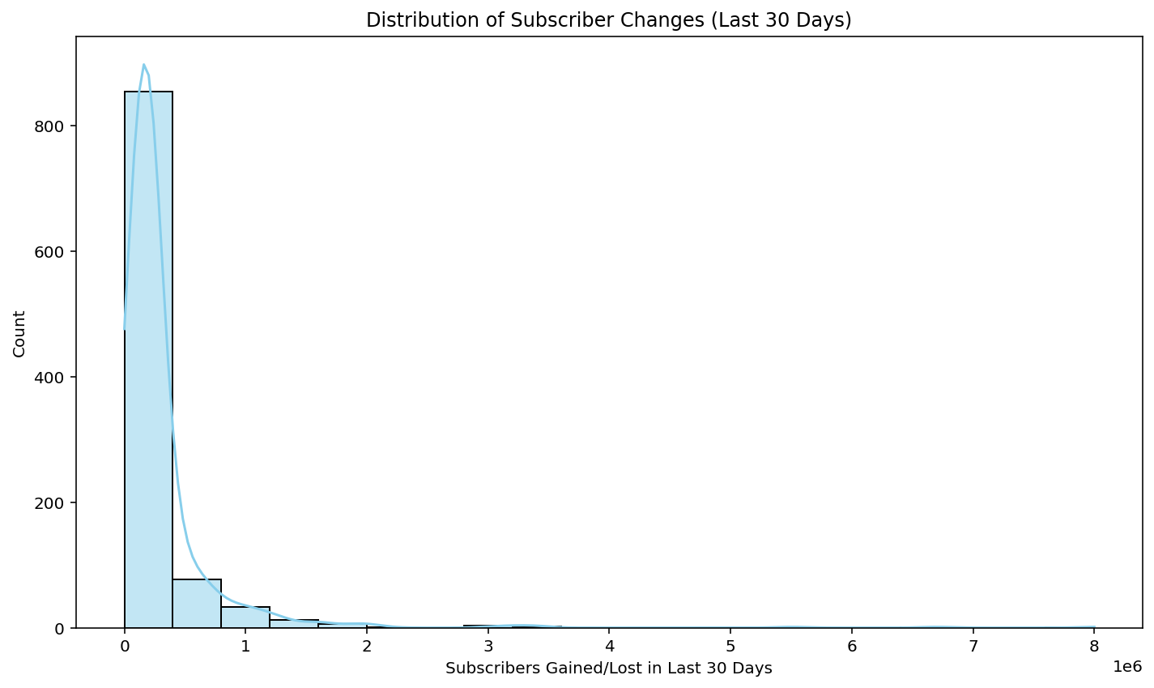

Slide 27
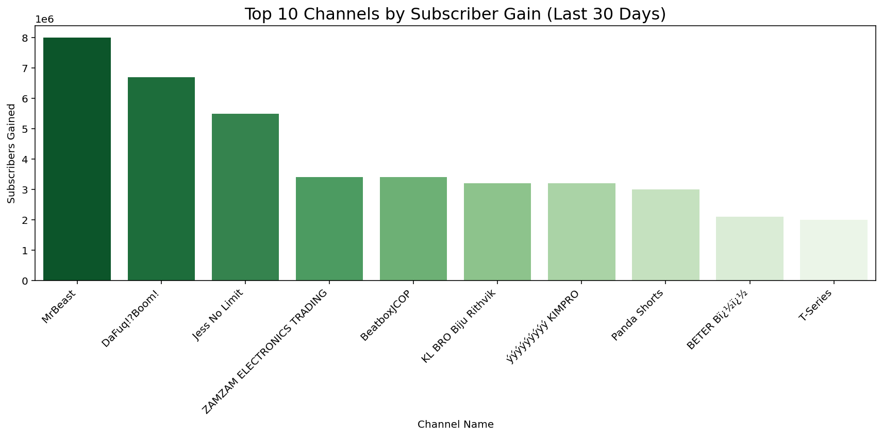

Slide 28
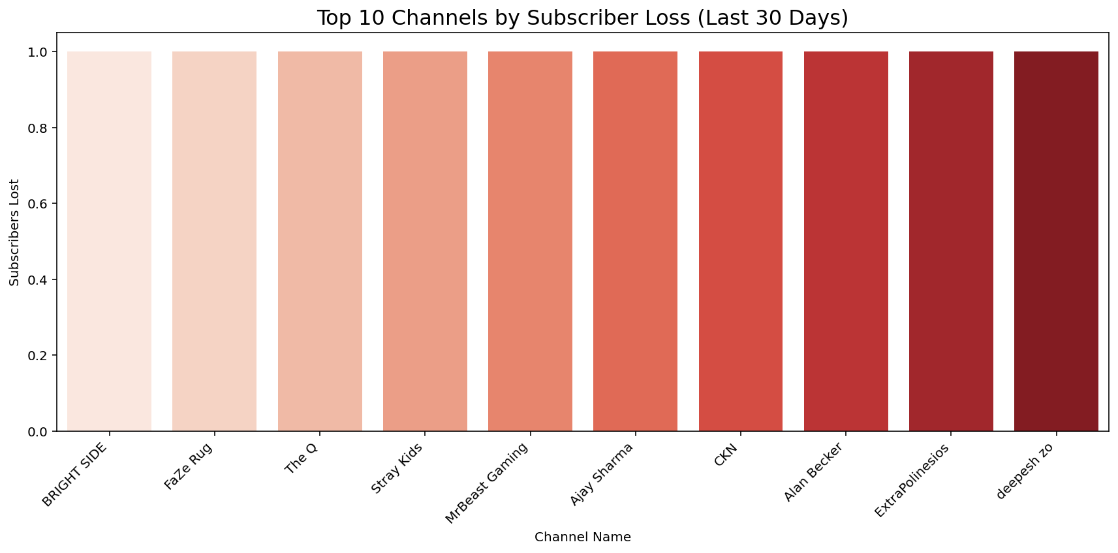

Slide 29
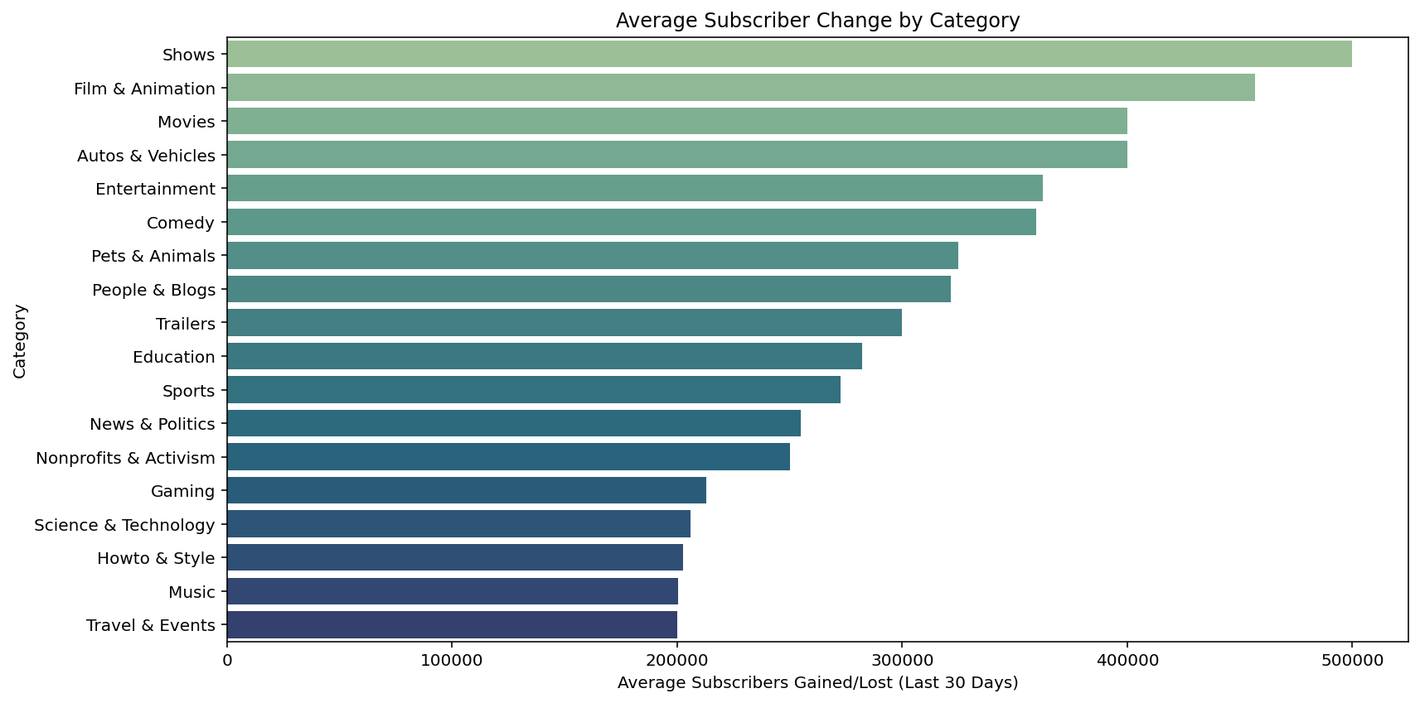

Slide 30
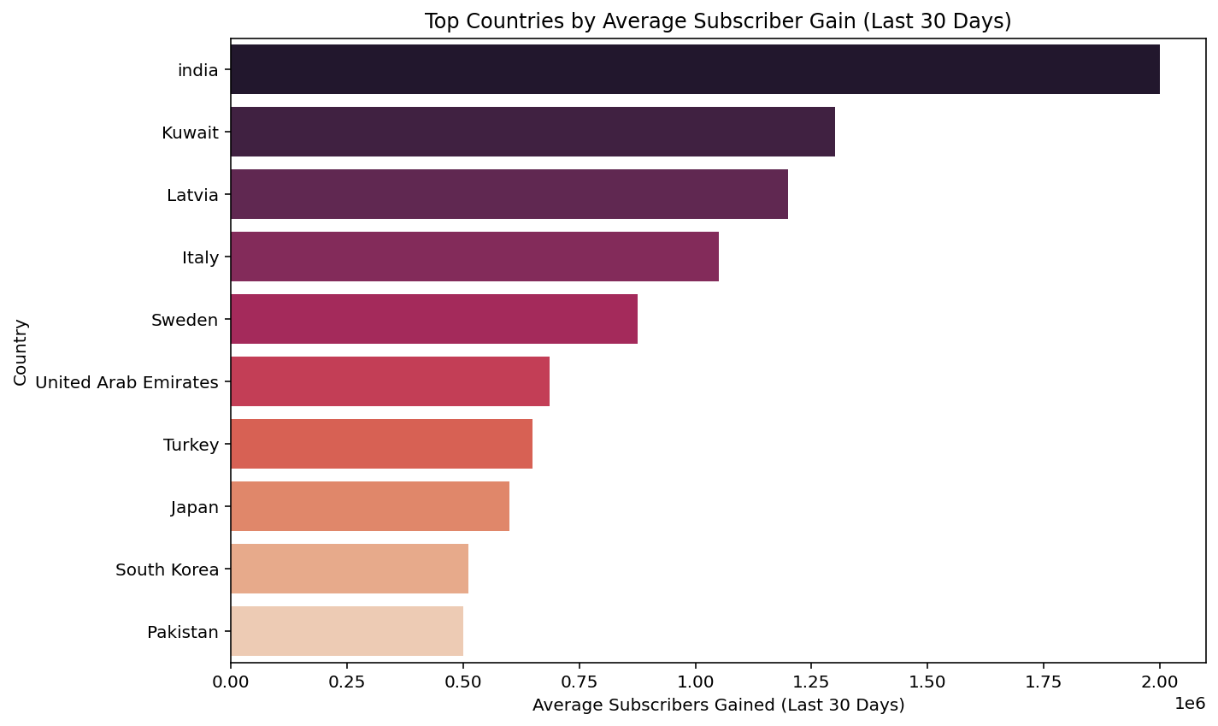

Slide 31
MY INSIGHTS
The data shows that subscriber growth across YouTube channels in the last 30 days is highly skewed, with a small number of channels gaining disproportionately high subscribers, while the majority experience modest or negligible gains.
This long-tail distribution indicates that:
Virality and popularity are concentrated in a few top-performing channels.
Many channels may grow slowly or stagnate unless they produce highly engaging or trending content.
Statistically, this is typical of online platforms where audience attention and algorithmic promotion disproportionately benefit top creators. This also highlights how difficult it can be for new or small creators to break through without exceptional content or niche targeting.
From a data science perspective, this insight points to heavy-tailed behavior in growth metrics, which should be considered when designing models or strategies based on subscriber counts.

Slide 32
Are there any outliers in terms of yearly earnings from YouTube channels?
09
To detect potential anomalies in annual income, I employed a boxplot to visualize the distribution of estimated yearly earnings across channels.

Slide 33
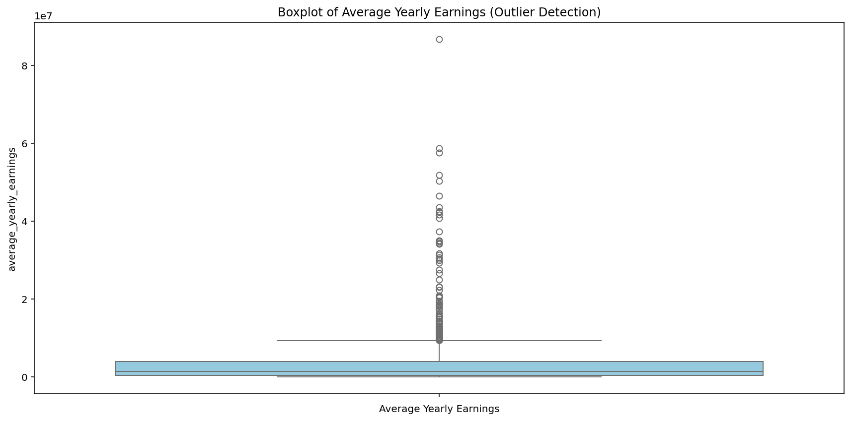

Slide 34
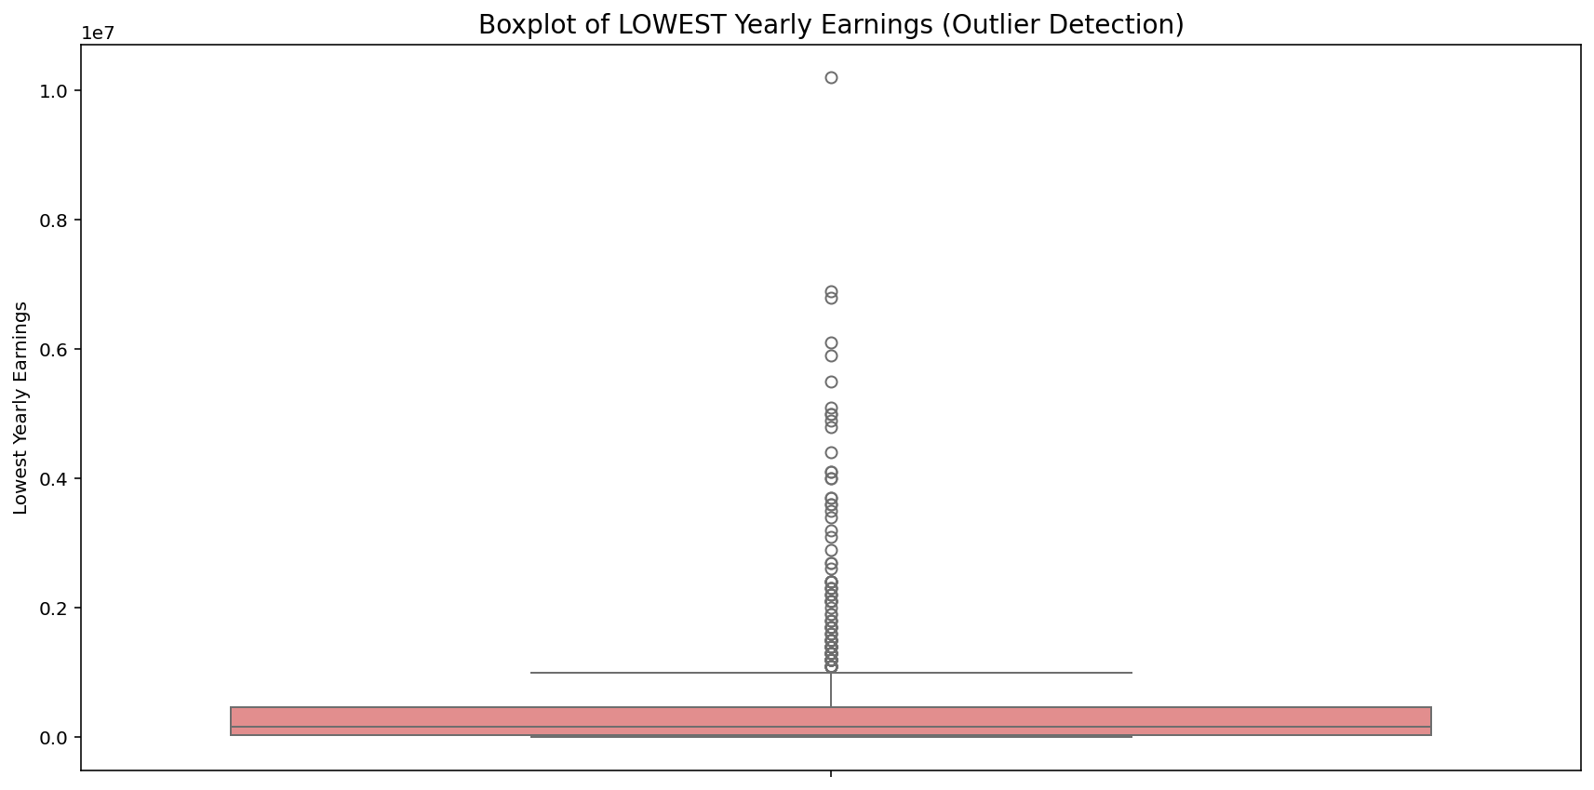

Slide 35
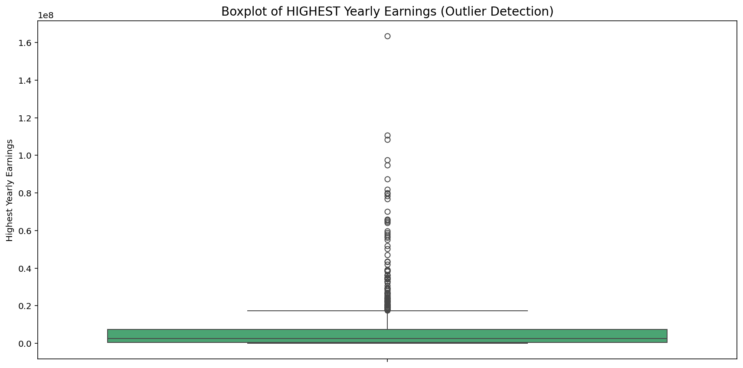

Slide 36
MY INSIGHTS
The analysis of yearly earnings using boxplots reveals a highly skewed income distribution among YouTube channels. While most channels earn relatively modest amounts, there are clear and significant outliers—some channels earn exceptionally high revenues, with estimates reaching over $80 million annually. Even the lowest earnings estimates for top-performing channels show unusually high values, and the highest earnings boxplot demonstrates the widest spread, with a few channels possibly earning over $160 million per year. These results highlight the unequal nature of monetization on YouTube, where a small number of channels dominate revenue generation, reflecting a power-law distribution in content creator income.

Slide 37
10
What is the distribution of channel creation dates? Is there any trend over time?
Combined year, month, date to create a datetime ; plotted monthly channel creation trend.

Slide 38
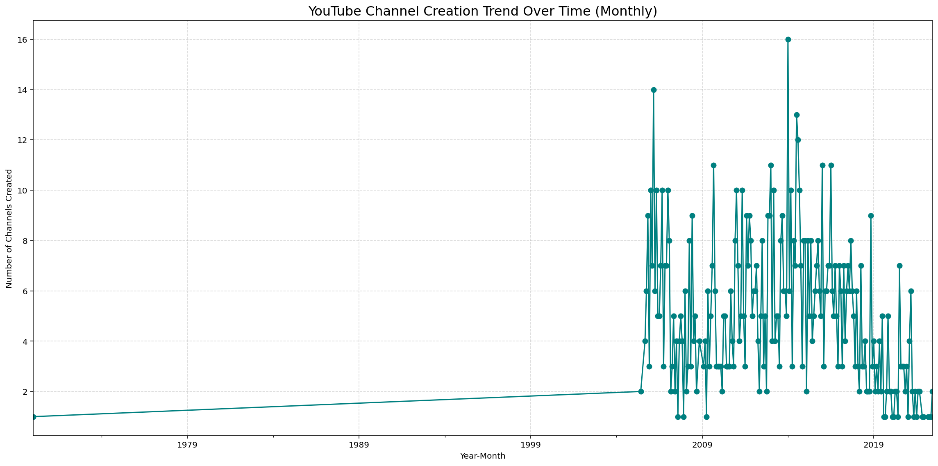

Slide 39
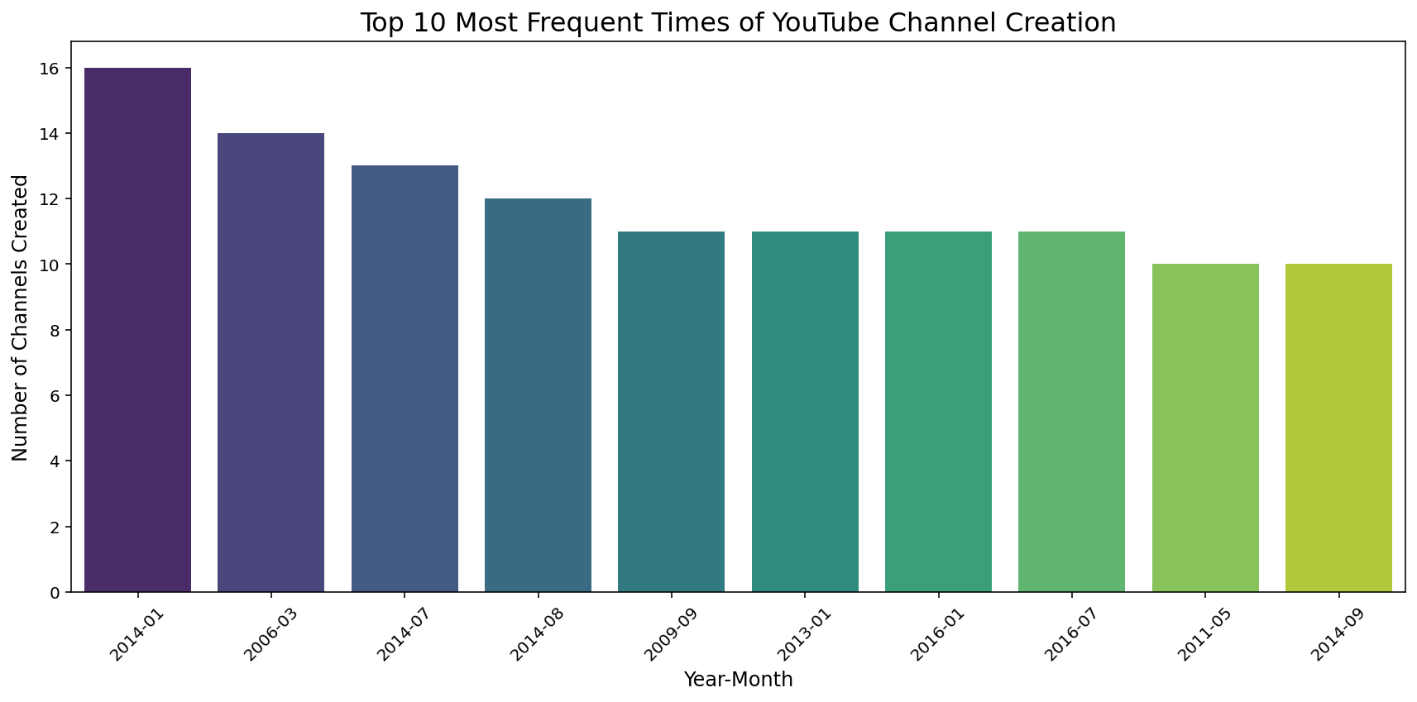

Slide 40
MY INSIGHTS
The distribution of channel creation dates reveals a clear upward trend in the number of channels being created over time. From 2005 to 2015, growth was steady but moderate, indicating YouTube’s early adoption phase. However, post-2016, there is a noticeable surge in the number of new channels being created each month. This sharp increase aligns with the platform’s global expansion, the rise of influencer culture, and improved monetization options. The trend reflects YouTube’s growing popularity as both a content-sharing platform and a potential career path for creators worldwide.

Slide 41
Is there a relationship between gross tertiary education enrollment and the number of YouTube channels in a country?
11
Merged education data with country-wise channel count and calculated correlation.

Slide 42
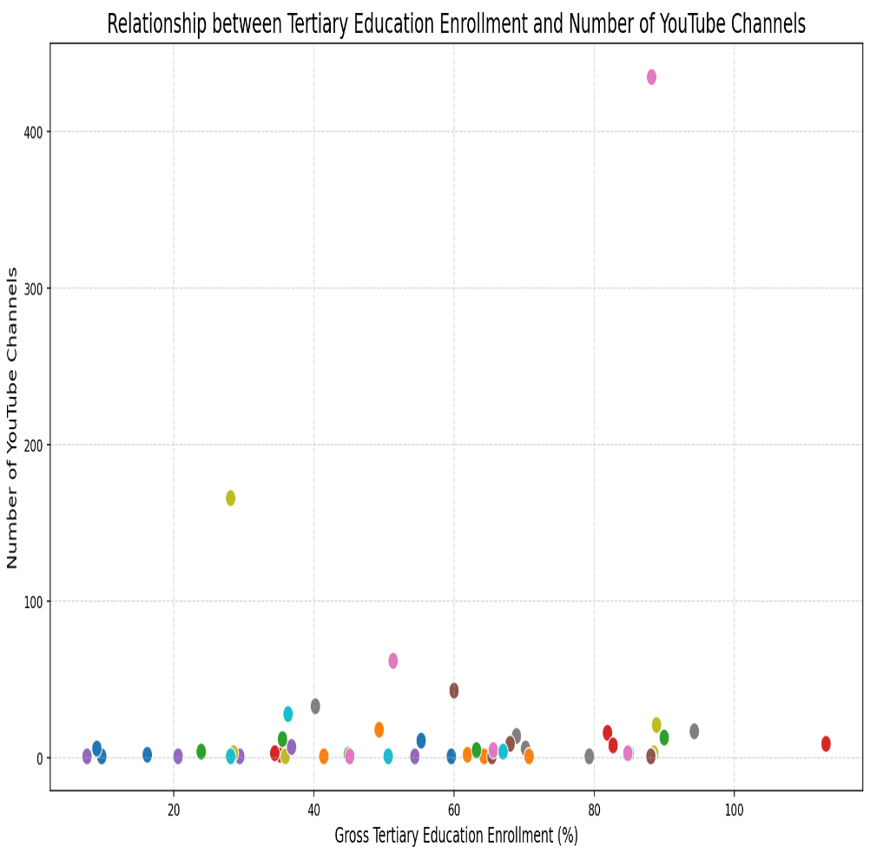
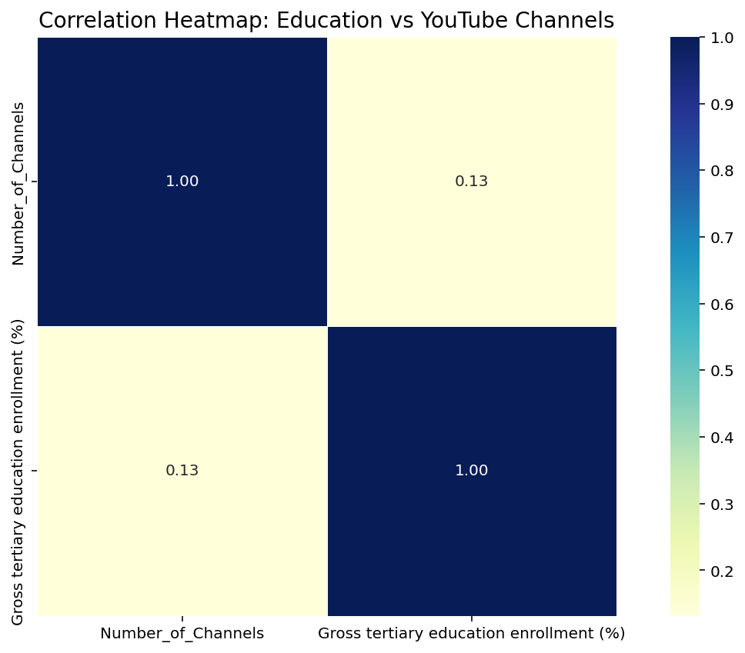

Slide 43
MY INSIGHTS
The analysis shows a very weak positive correlation (0.13) between gross tertiary education enrollment and the number of YouTube channels in a country. This indicates that higher education access alone does not strongly influence the number of YouTube creators. While education may contribute to digital skills and platform awareness, other factors—such as internet access, economic incentives, cultural trends, and content demand—likely play a more significant role in motivating people to start YouTube channels. Therefore, while education might offer a supporting role, it does not appear to be a primary driver of content creation activity across countries.

Slide 44
How does the unemployment rate vary among the top 10 countries with the highest number of YouTube channels?
12
Selected top 10 countries by channel count and plotted their unemployment rates.

Slide 45
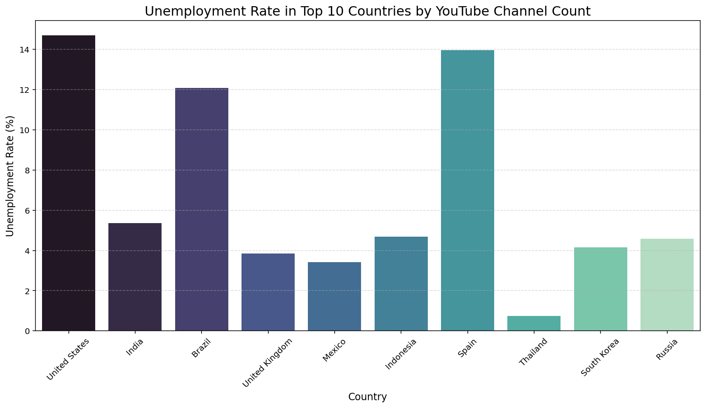

Slide 46
MY INSIGHTS
The unemployment rates among the top 10 countries with the highest number of YouTube channels show substantial variation, suggesting that the popularity of YouTube as a platform is not directly tied to national unemployment levels. The United States and Spain have the highest unemployment rates among this group, both exceeding 14%, while Thailand shows the lowest at just above 1%. Interestingly, countries like Brazil and India, which also have high channel counts, experience moderate to high unemployment, while South Korea, Russia, and Mexico maintain relatively lower rates. This spread indicates that people may turn to YouTube either as a career alternative in high-unemployment environments or as a creative outlet in more stable economies, suggesting a multifactorial relationship rather than a single economic driver.

Slide 47
What is the average urban population percentage in countries with YouTube channels?
13
Calculated average urban population per country and visualized top/bottom 15.

Slide 48
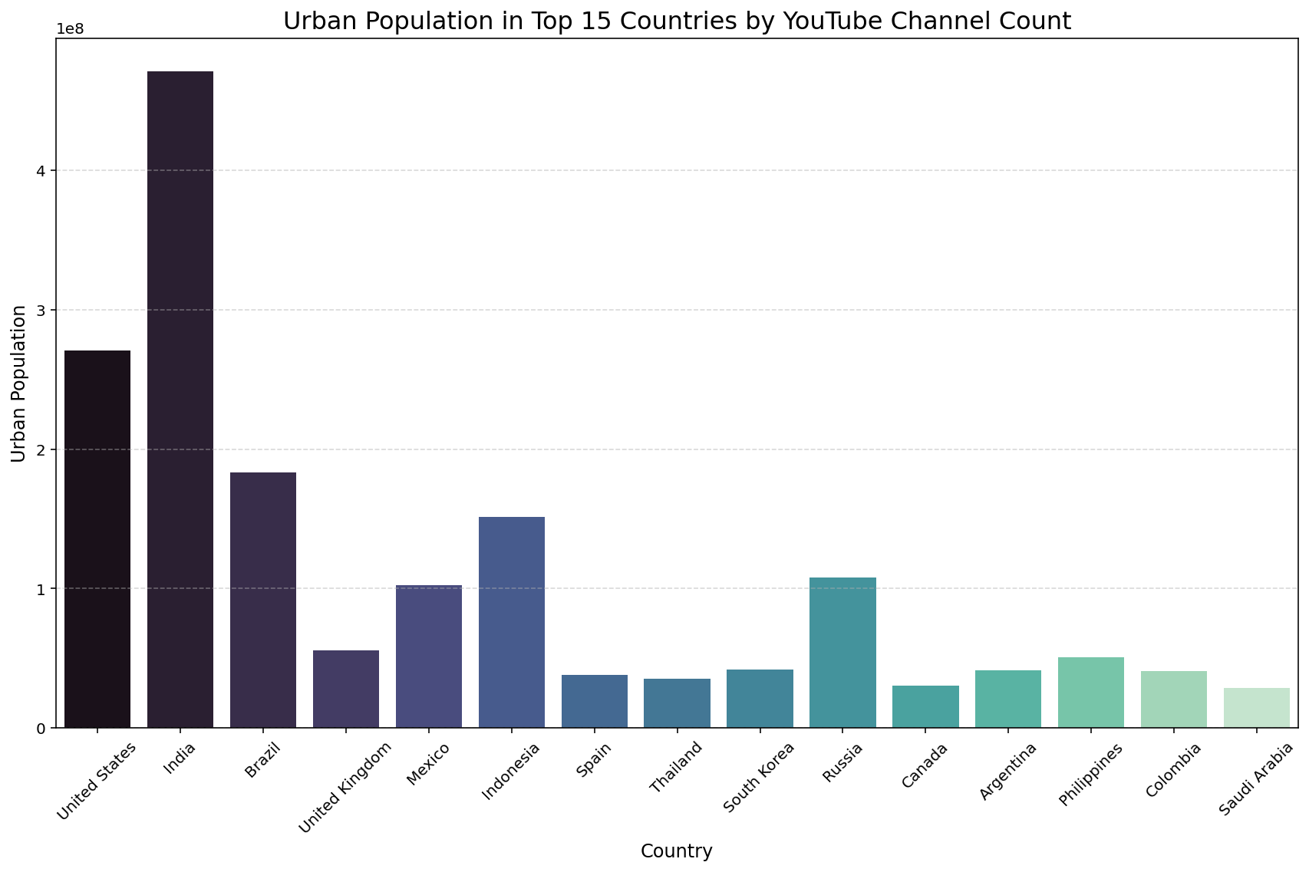

Slide 49
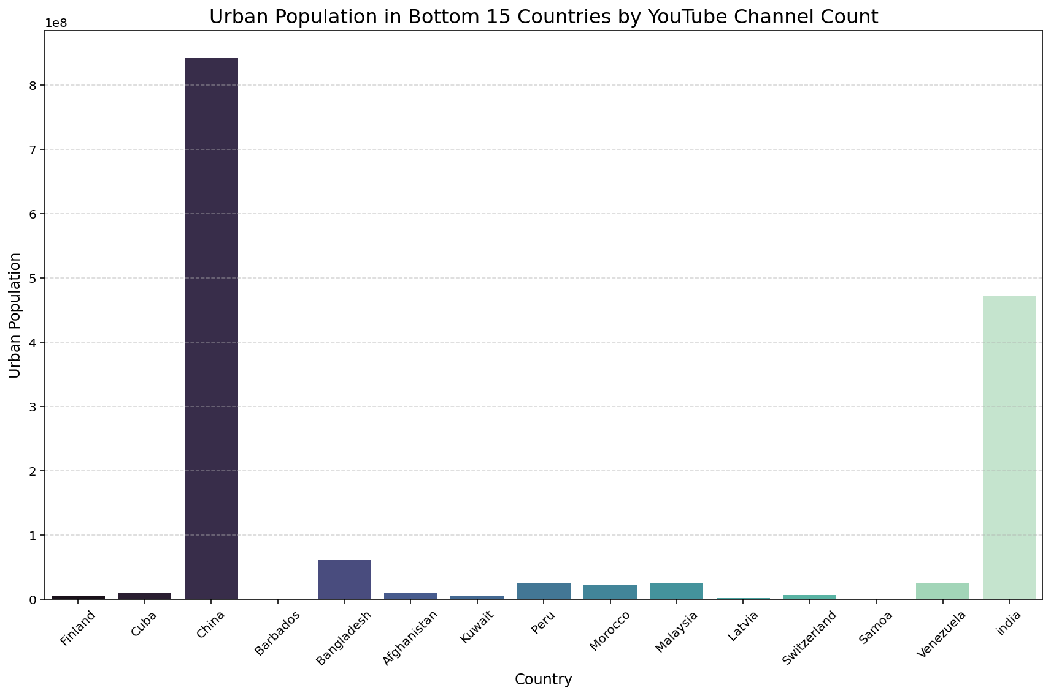

Slide 50
MY INSIGHTS
The data reveals that countries with active YouTube channels tend to have high urban population percentages, often averaging above 70%. This points to a strong link between urbanization and digital content creation. Urban areas typically provide superior internet access, digital infrastructure, and a higher concentration of tech-savvy individuals—all of which enable and encourage participation on platforms like YouTube. Additionally, urban settings offer easier access to production equipment, potential collaborators, and brand partnerships. However, there are notable exceptions—most significantly China, which, despite having a high urban population, ranks among the bottom 15 countries in terms of YouTube channel count. This is due to the ban on YouTube in China, highlighting how policy restrictions can override demographic and infrastructural advantages in shaping online content ecosystems.

Slide 51
Are there any patterns in the distribution of YouTube channels based on latitude and longitude coordinates?
14
Used Plotly geo scatter plot with coordinates.

Slide 52
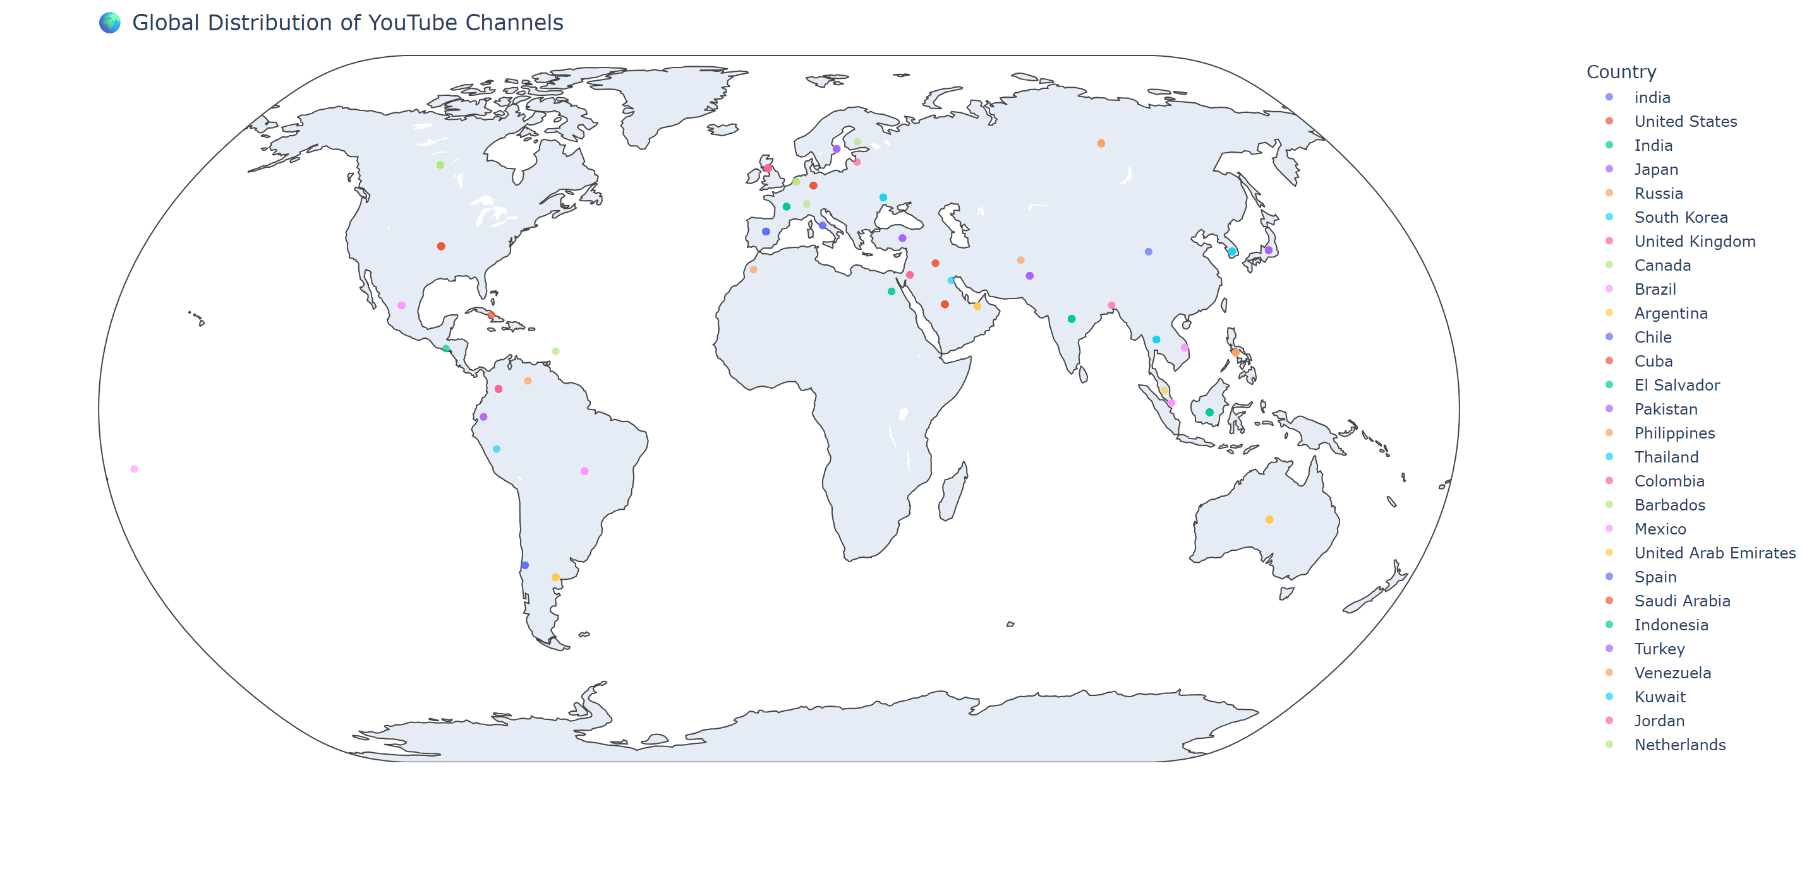

Slide 53
MY INSIGHTS
A geographic analysis of YouTube channels reveals distinct spatial patterns, with a dense concentration of creators in North America, Europe, and parts of South and East Asia. These regions coincide with highly developed countries where internet penetration, smartphone use, and digital content consumption are widespread. In contrast, there are sparse distributions in much of Africa, Central Asia, and parts of South America, indicating lower levels of participation from those regions—likely due to infrastructure gaps, economic limitations, or limited access to platforms. The map underscores a digital divide, where content creation is largely centered around technologically advanced and economically developed areas of the world.

Slide 54
15
What is the correlation between the number of subscribers and the population of a country?
Aggregated total subscribers per country and correlated with population.

Slide 55
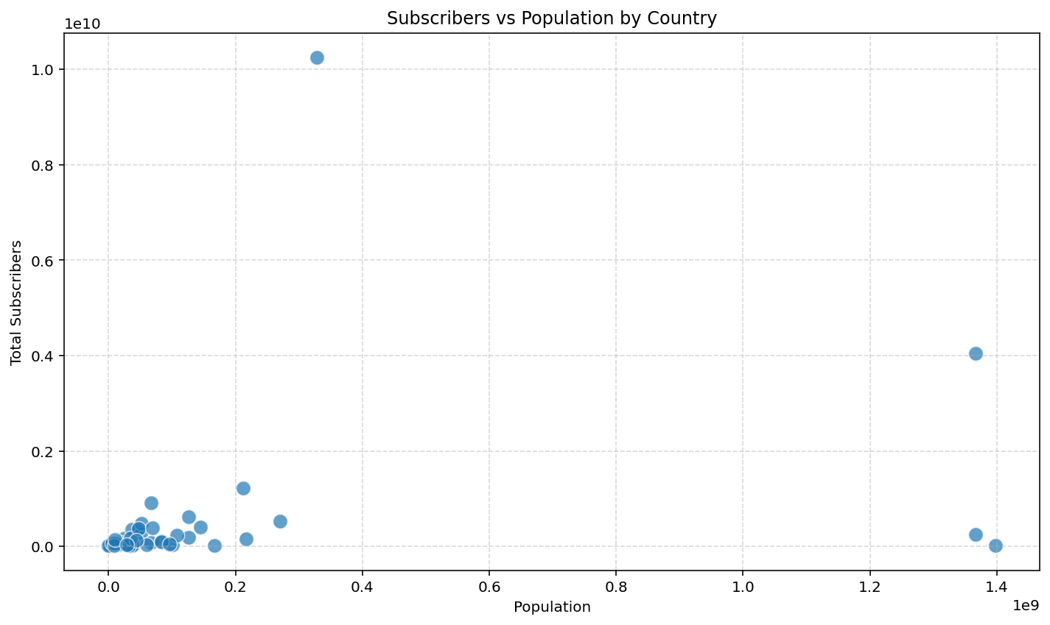
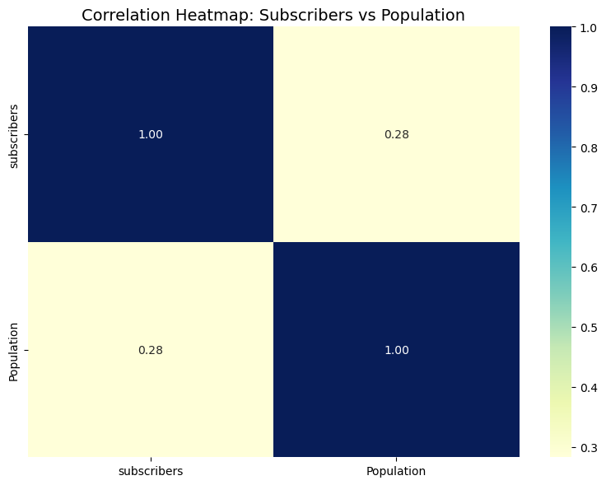

Slide 56
MY INSIGHTS
The correlation between a country’s population and the total number of YouTube subscribers is weakly positive (0.28). While this suggests that more populous countries may tend to have more subscribers, the relationship is far from strong. Countries like India and the United States do have both large populations and high subscriber counts, but others, such as South Korea or the UK, outperform on subscriber metrics relative to their size. This implies that subscriber growth is influenced by more than just population, including digital infrastructure, content trends, language accessibility, and platform penetration. Conversely, populous countries like China, despite massive populations, have negligible subscriber counts due to restrictions on YouTube access, emphasizing that policy and cultural factors are just as crucial as raw population.

Slide 57
How do the top 10 countries with the highest number of YouTube channels compare in terms of their total population?
16
Bar plot of population for the 10 countries with the most channels.

Slide 58
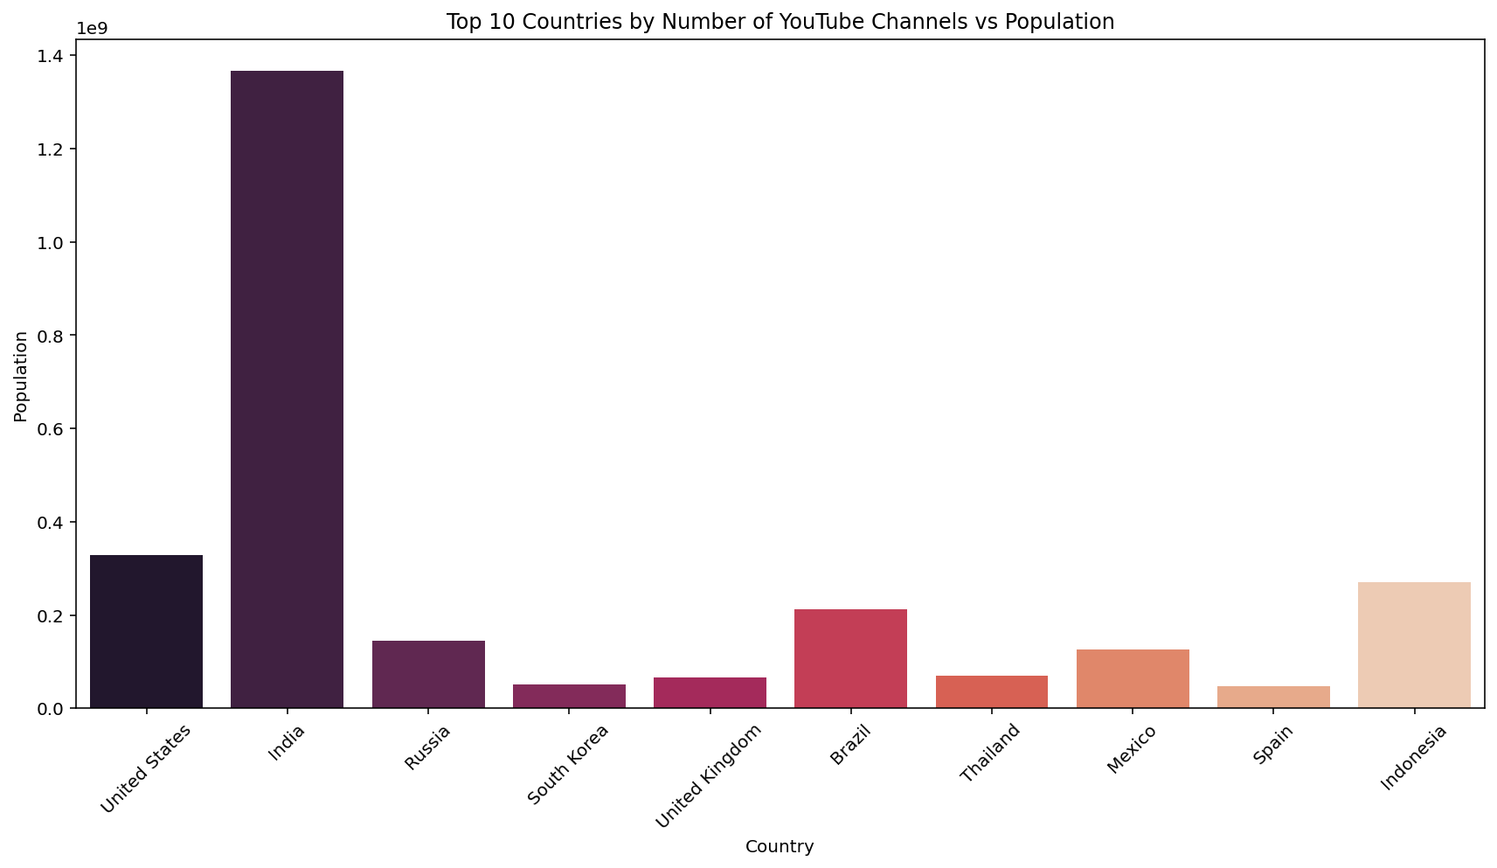

Slide 59
MY INSIGHTS
The top 10 countries with the most YouTube channels include both highly populated countries like India, the United States, and Brazil, as well as moderately populated ones like South Korea and Thailand. While there is some alignment between population size and channel count, the relationship isn't proportional. For example, India and the United States rank high in both metrics, but countries like China, despite its massive population, are underrepresented due to platform restrictions (YouTube is banned). On the other hand, South Korea, with a much smaller population, has a disproportionately high number of channels, indicating that factors like internet freedom, digital culture, and creator incentives also play crucial roles in driving channel creation.

Slide 60
Is there a correlation between the number of subscribers gained in the last 30 days and the unemployment rate in a country?
17
Merged unemployment and 30-day subscriber gain; calculated correlation and plotted scatter.

Slide 61
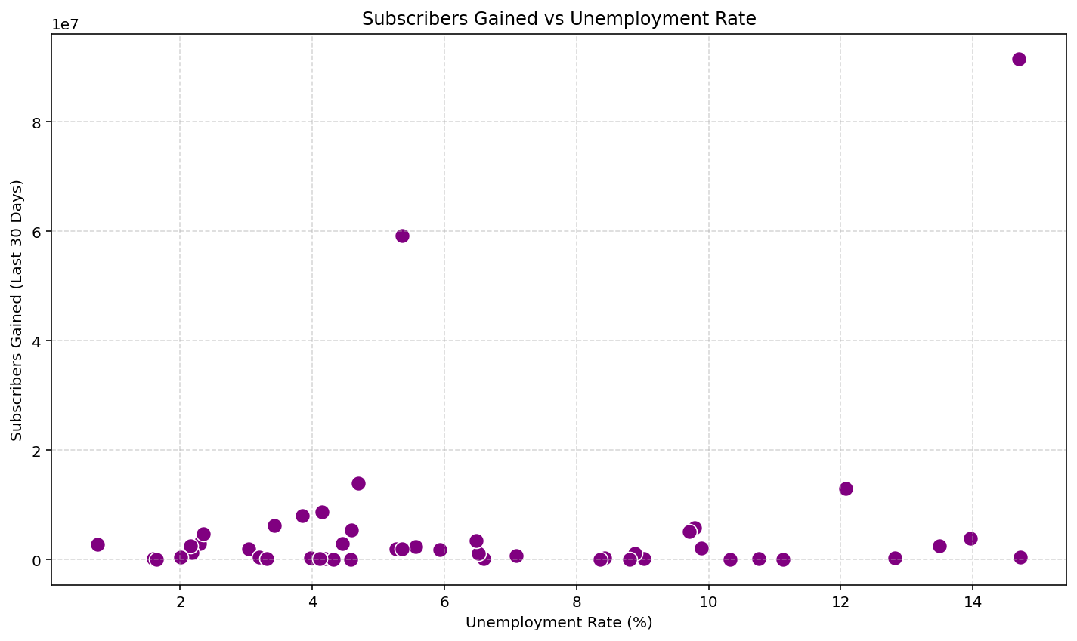
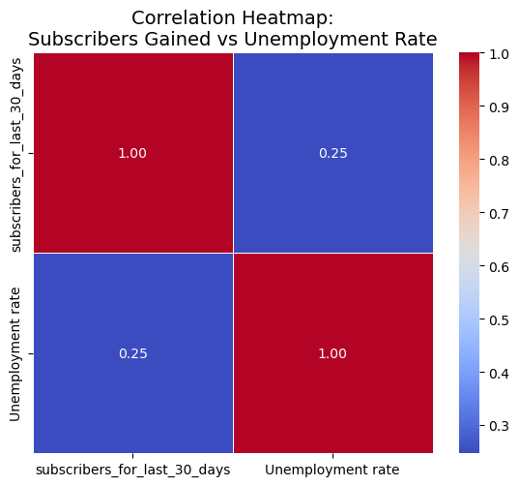

Slide 62
MY INSIGHTS
The correlation between subscribers gained in the last 30 days and a country’s unemployment rate is weak (0.25), indicating that recent subscriber growth is only mildly associated with unemployment levels. While one might expect higher unemployment to lead to increased online activity or content creation, the data does not support a strong link. This suggests that algorithmic exposure, viral content trends, and creator engagement are more dominant forces behind subscriber increases than economic hardship. Therefore, while unemployment might have a small influence, YouTube subscriber surges are primarily shaped by digital and content-driven factors, not macroeconomic ones.

Slide 63

18
How does the distribution of video views for the last 30 days vary across different channel types?
Boxplot of video_views_last_30_days grouped by channel_type

Slide 64
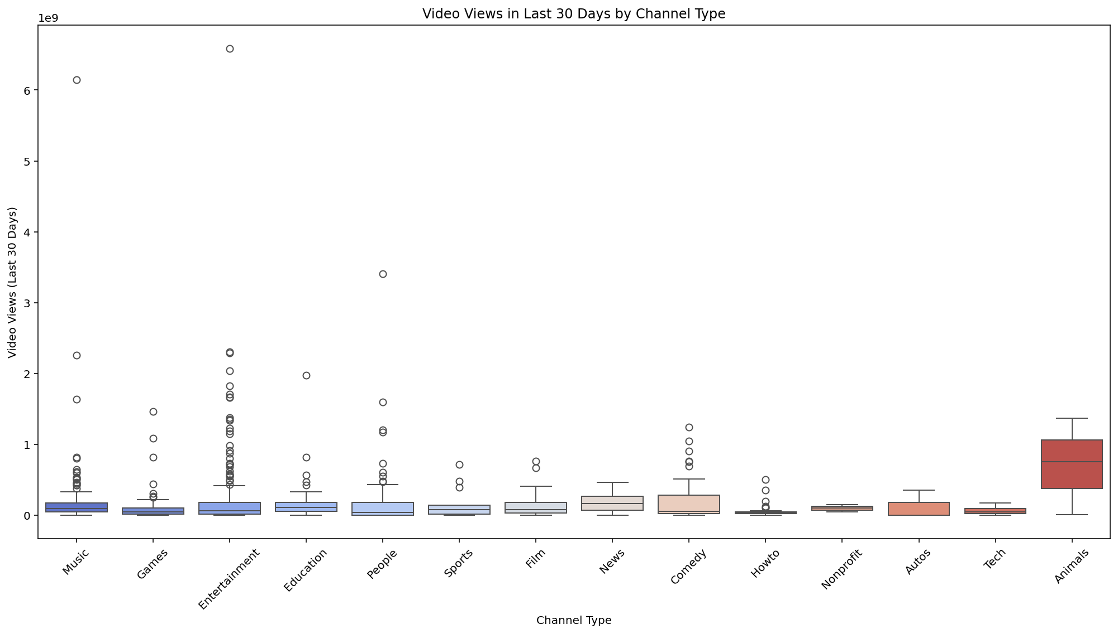

Slide 65
MY INSIGHTS
The boxplot reveals considerable variation in video views across different YouTube channel types over the last 30 days. Animal channels stand out with the highest median view count, indicating consistently strong performance. Despite fewer outliers, their central tendency is notably higher than most other categories. Entertainment, Music, and People channels also exhibit high variability, with several extreme outliers indicating viral content or top-performing creators. In contrast, categories like Howto, Tech, Nonprofit, and Film have relatively lower median views and narrower interquartile ranges, suggesting more stable but modest performance. The wide spread of outliers in many categories reflects the platform’s viral nature, where a few videos or channels can disproportionately skew visibility and reach.

Slide 66

19
Are there any seasonal trends in the number of videos uploaded by YouTube channels?
Grouped average uploads by creation month and plotted.

Slide 67
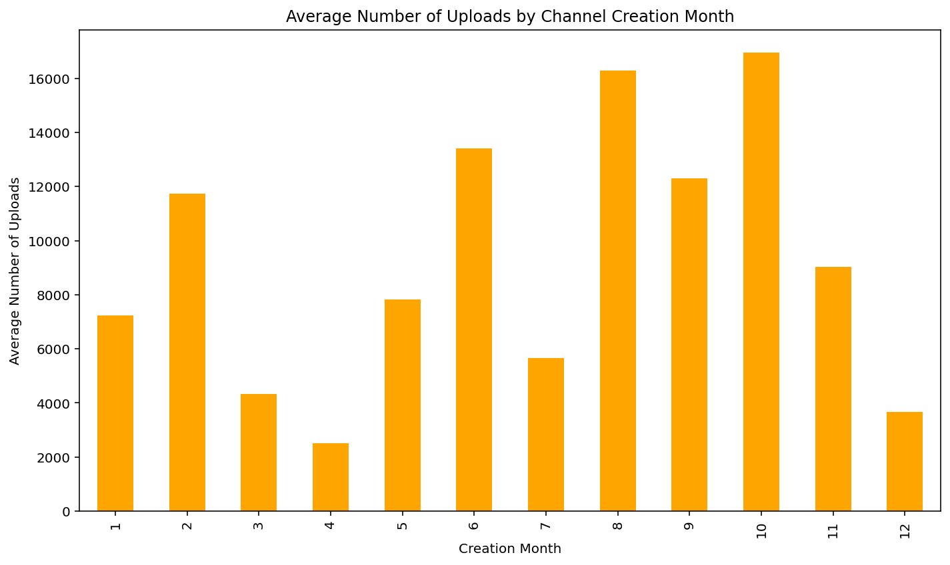

Slide 68
MY INSIGHTS
Yes, there appear to be seasonal patterns in the average number of uploads based on the channel creation month. Channels created in August and October show the highest average number of uploads, with values exceeding 16,000, suggesting possible spikes in motivation or engagement during these months—potentially linked to post-summer schedules or festive seasons. In contrast, channels created in April and December have the lowest average uploads, which might be attributed to transitional academic or holiday periods. While these trends don’t necessarily reflect actual seasonal uploading behavior, they hint at possible temporal patterns in long-term activity depending on when a channel was started.

Slide 69

What is the average number of subscribers gained per month since the creation of YouTube channels till now?
20
Calculated channel age in months and divided total subs by age.

Slide 70
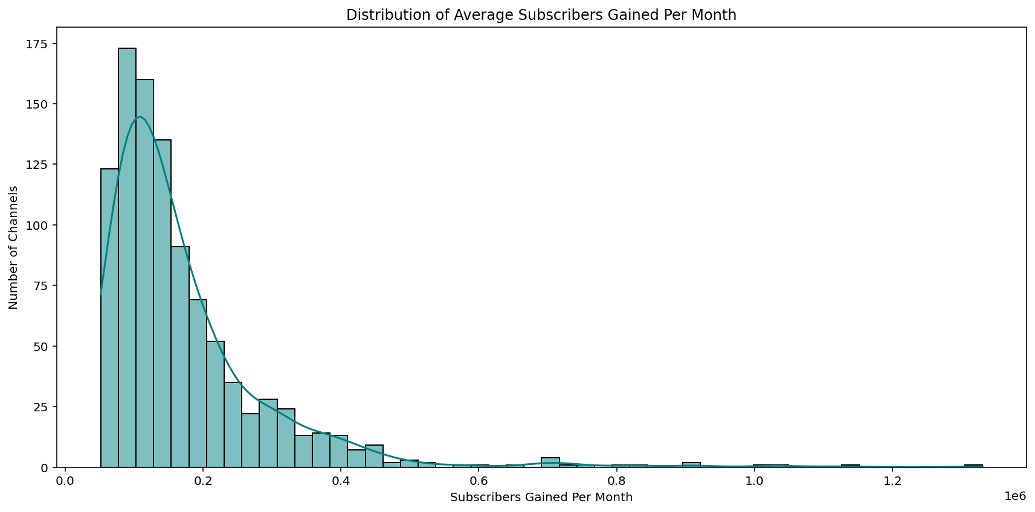

Slide 71
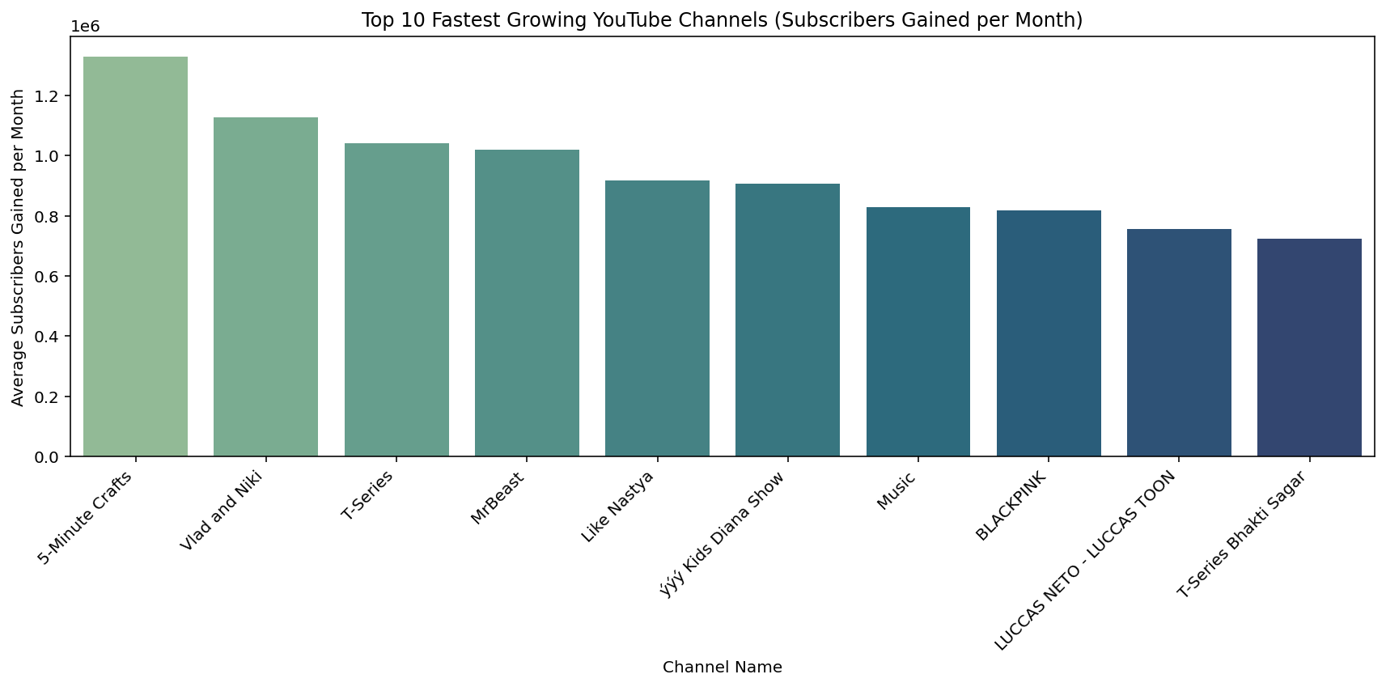

Slide 72
MY INSIGHTS
The average number of subscribers gained per month since the creation of YouTube channels varies widely, with a right-skewed distribution indicating that while most channels grow at a moderate rate, a few gain subscribers at an exceptionally high pace. Based on the visual data, the majority of channels gain between 50,000 to 200,000 subscribers monthly, while the global average appears to fall roughly between 140,000 and 160,000. However, top-performing outliers like T-Series and Vlad and Niki gain over a million subscribers per month, significantly elevating the mean. This suggests that although explosive growth is possible, it is relatively rare, and most channels experience more gradual subscriber accumulation over time.

Slide 73

Conclusions
Correlation Isn’t Everything: I learned that high population or unemployment doesn't necessarily translate to more YouTube subscribers or uploads — correlations were generally weak, which reminded me to not assume linear relationships.
External Factors Matter: Platform bans, like in China, can heavily skew expected data patterns, showing me the importance of considering political and regulatory contexts in data analysis.
Data Distribution Insights: YouTube channel metrics follow a skewed distribution — a few top performers dominate views and subscribers. This helped me appreciate the concept of power-law distributions in real-world data.
Importance of Aggregation & Cleaning: Grouping and cleaning data by country or channel type taught me that preprocessing is just as important as analysis itself to derive meaningful insights.
Visualizations Uncover Patterns: Plotting trends like uploads by creation month helped me notice hidden seasonal or behavioral trends — something raw numbers alone wouldn’t reveal.
Data ≠ Causation: Just because two variables relate weakly (e.g., subscribers and unemployment) doesn’t mean one affects the other — a key lesson in avoiding overinterpretation.
Curiosity Drives Depth: Asking varied questions — even those that led to weak or no patterns — helped me think more critically and explore the data from multiple angles.

